Slide 1
Why Study German?

Slide 2
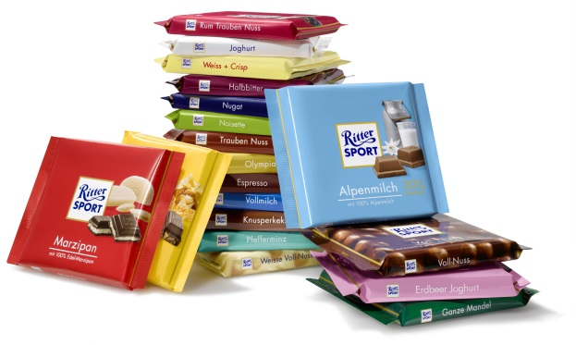
Germany is the world’s third leading exporter, exporting over a TRILLION dollars worth of products.

Slide 3
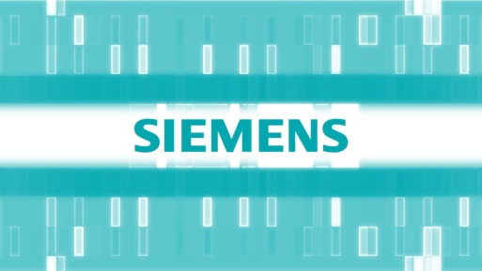
Knowing German creates business opportunities. More than 2,000 major American firms do business in German-speaking countries. More than 1,100 German companies do business in the US, providing an estimated one million jobs for Americans.
Willy Brandt, a former German chancellor, once said: “If I’m selling to you, I speak your language. If I’m buying from you, dann müssen Sie Deutsch sprechen.”

Slide 4
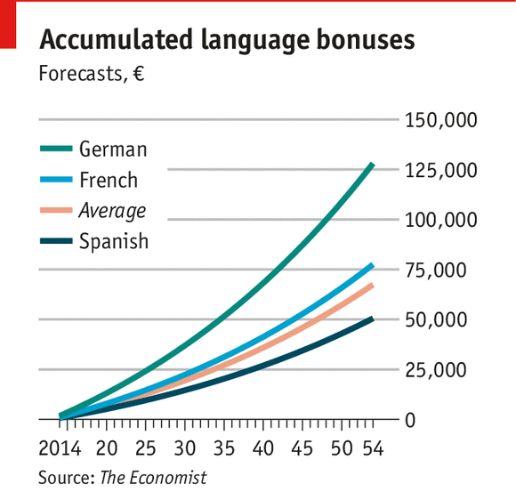
Knowing German can boost your annual salary in the US by 4%, in Europe by even more.

Slide 5
18% of all books published in the world are in German.

Slide 6
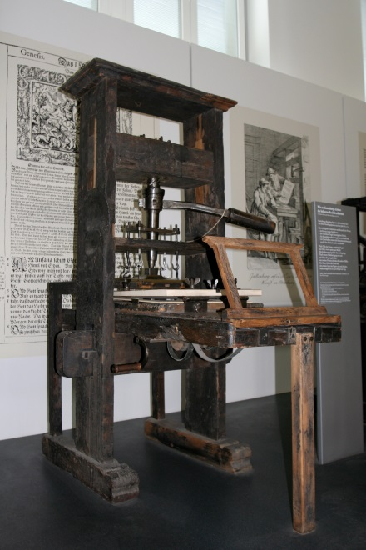
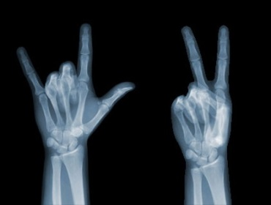
Throughout history, Germans have been innovators. Today, 4 of the world's 10 most innovative companies are located in Germany. More than 200,000 businesses introduce new high-tech products on the market each year.

Slide 7
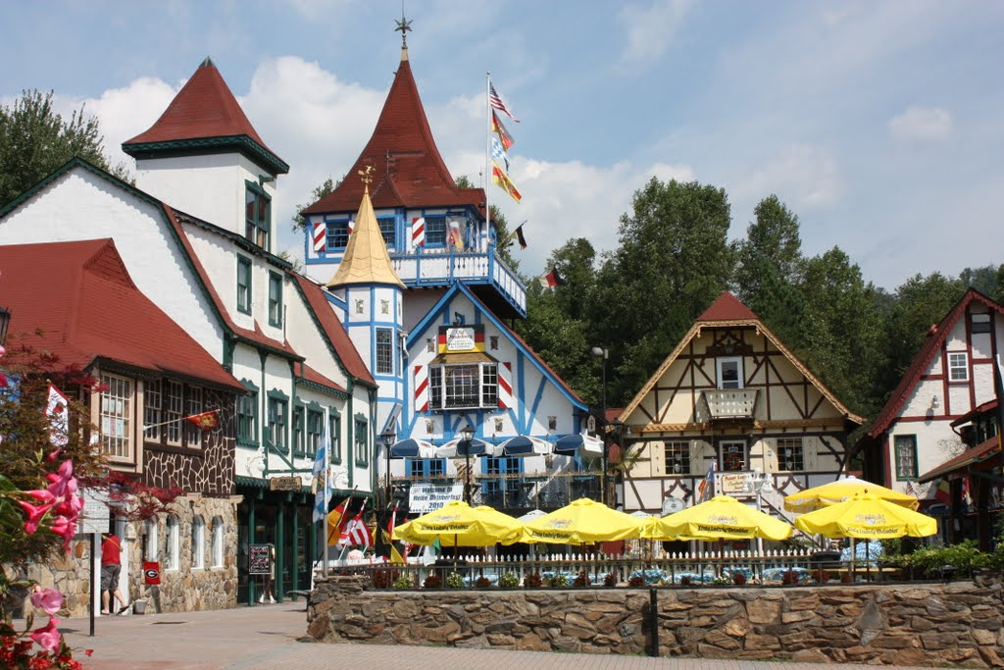
Almost 20% of all Americans claim German ancestry.
This heritage is felt throughout the country, in names like Brunswick, GA, in festivals like the Oktoberfest, in holiday traditions (Christmas tree, Easter Bunny, etc.), in words like kindergarten, angst, zeitgeist, and many more.

Slide 8
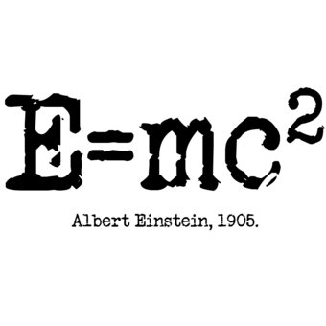
German is the language of Luther, Goethe, Nietzsche, Kafka, Mozart, Bach, Freud, Beethoven, and Einstein as well as many more influential authors and artists. Knowing German helps better understand their work.

Slide 9
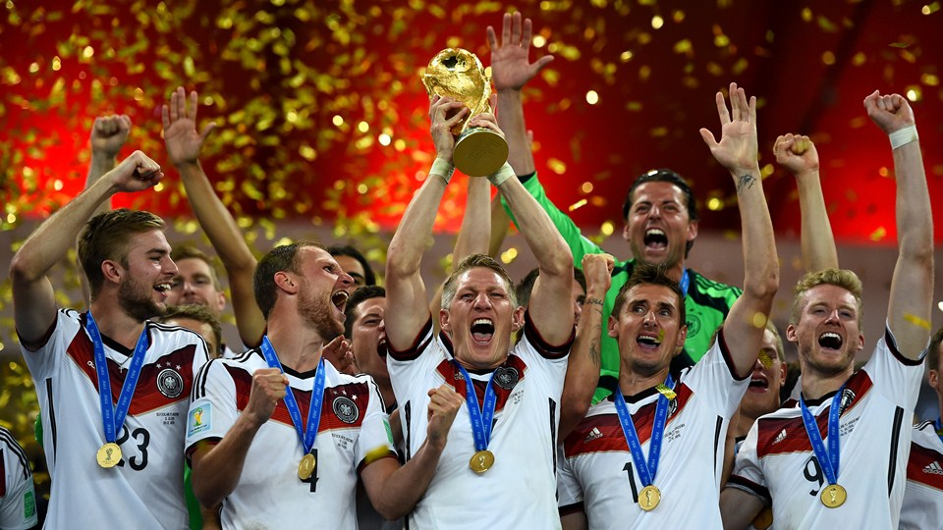
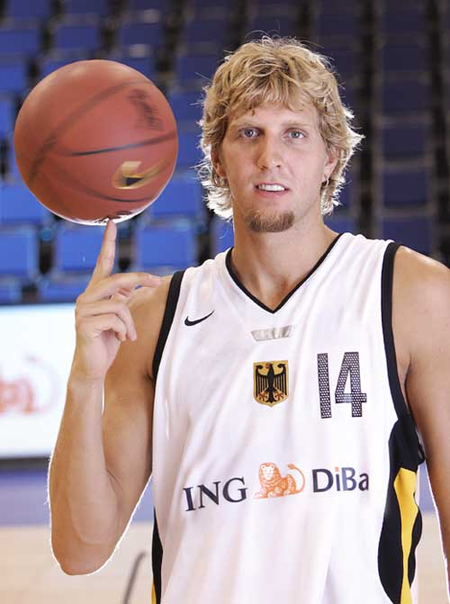
Deutschland ist Sportland!

Slide 10
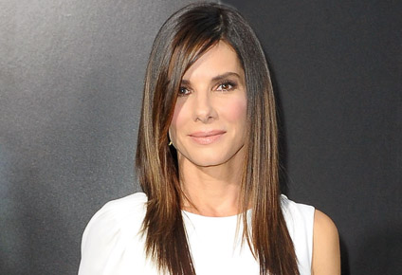
Deutschland ist Filmland!

Slide 11
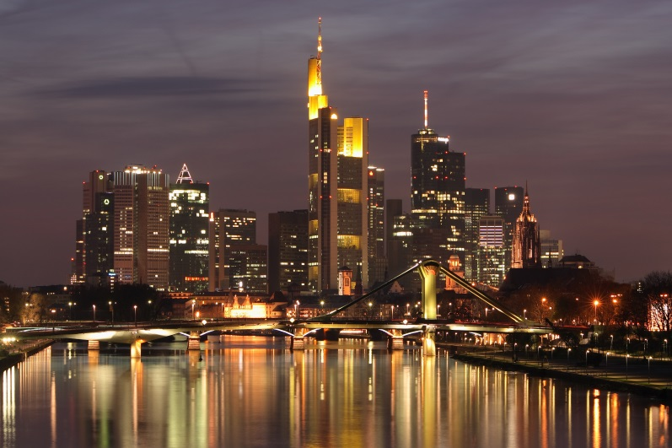
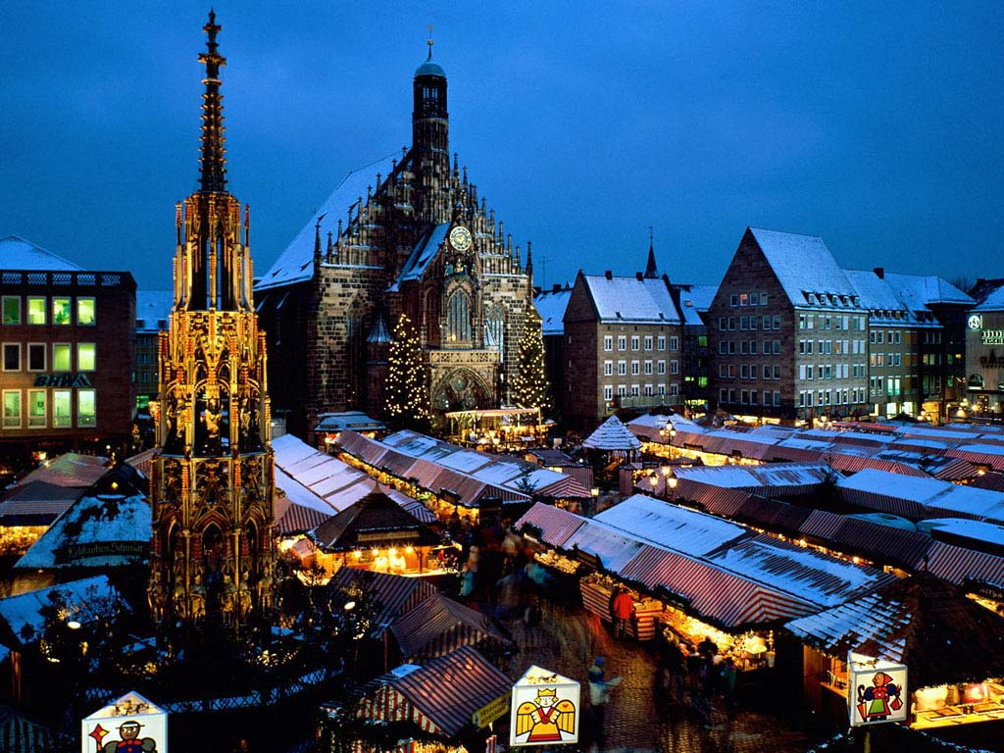
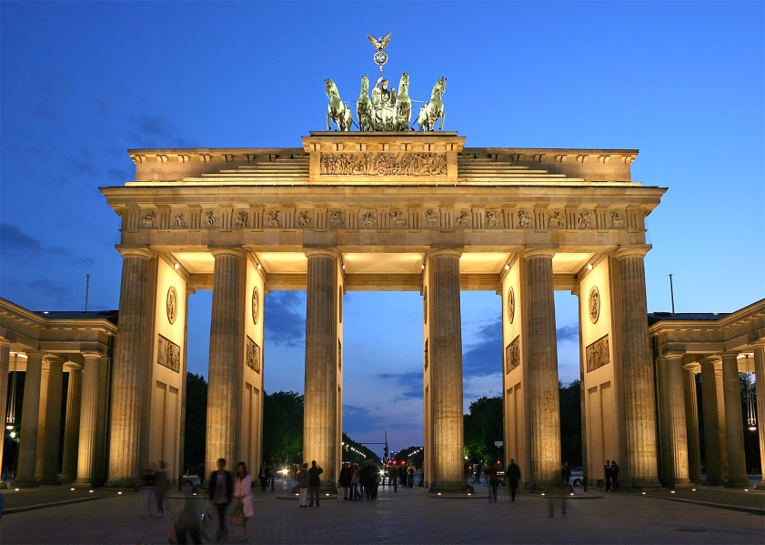
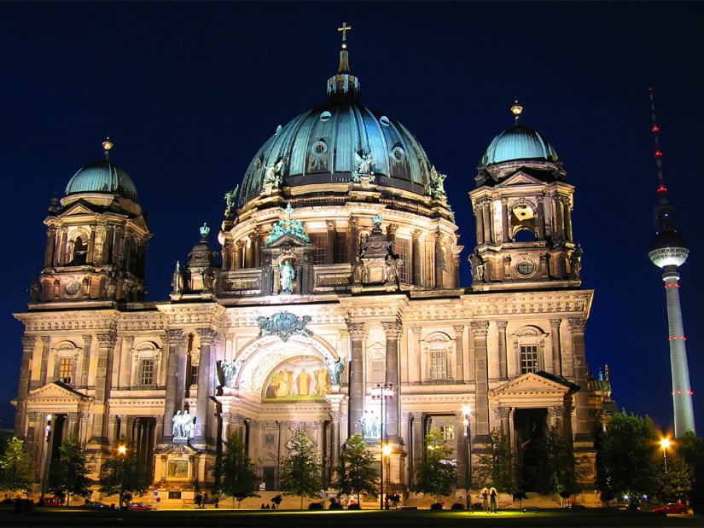
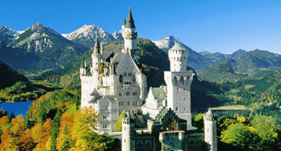
Deutschland ist wunderbar!

